Slide 1
Data
American Community Survey
The American Community Survey (ACS) is an ongoing survey that provides vital information on a yearly basis about our nation and its people. Every year, the U.S. Census Bureau contacts over 3.5 million households across the country to participate in the American Community Survey.
Through the ACS, we know more about jobs and occupations, educational attainment, veterans, whether people own or rent their homes, and other topics.

Slide 2
Variable
Code | Description
25-29 | The ratio of people between 25-29 to people between 13-17
SEX | Proportion of male in the population between 25-65
RACEWHT | Proportion of white population in the population between 25-65
VALUEH | The average housing value

Slide 3
Continued:
employment | The employment rate for population between 25-65
children | Proportion of people under 12
college | Proportion of people in the college in the population between 18-22
educc | Proportion of people having college degree in the population between 25-29
income1 | The average income for people between 25-29

Slide 4
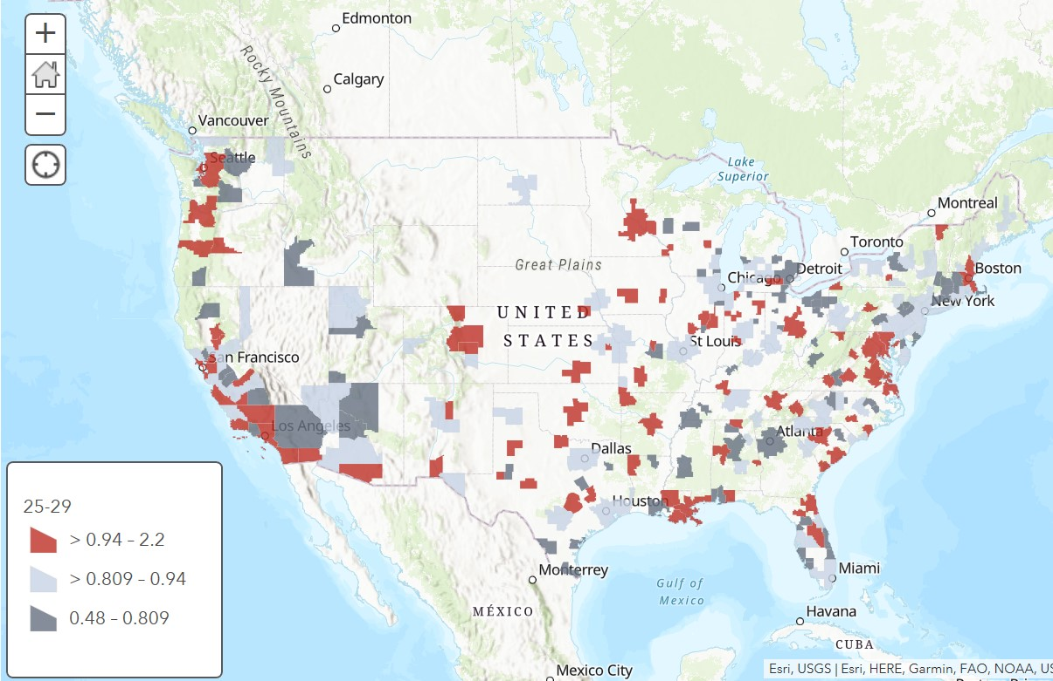

Slide 5
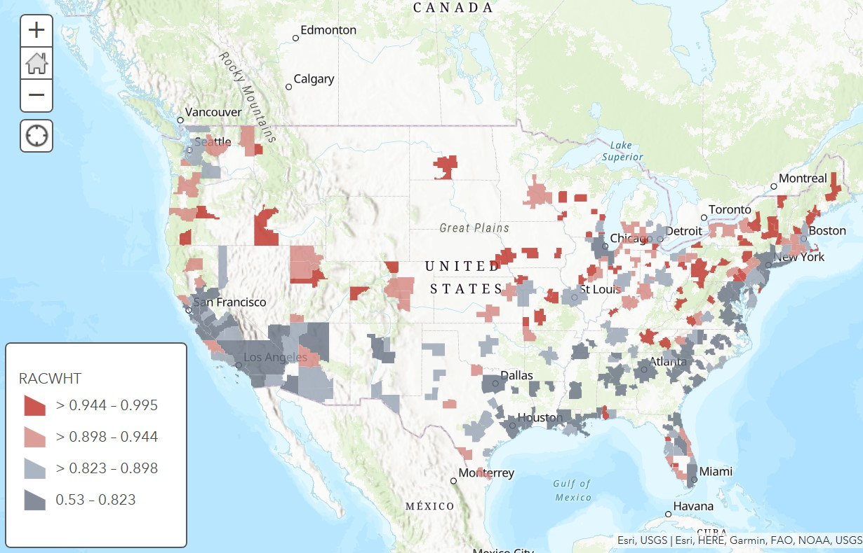

Slide 6
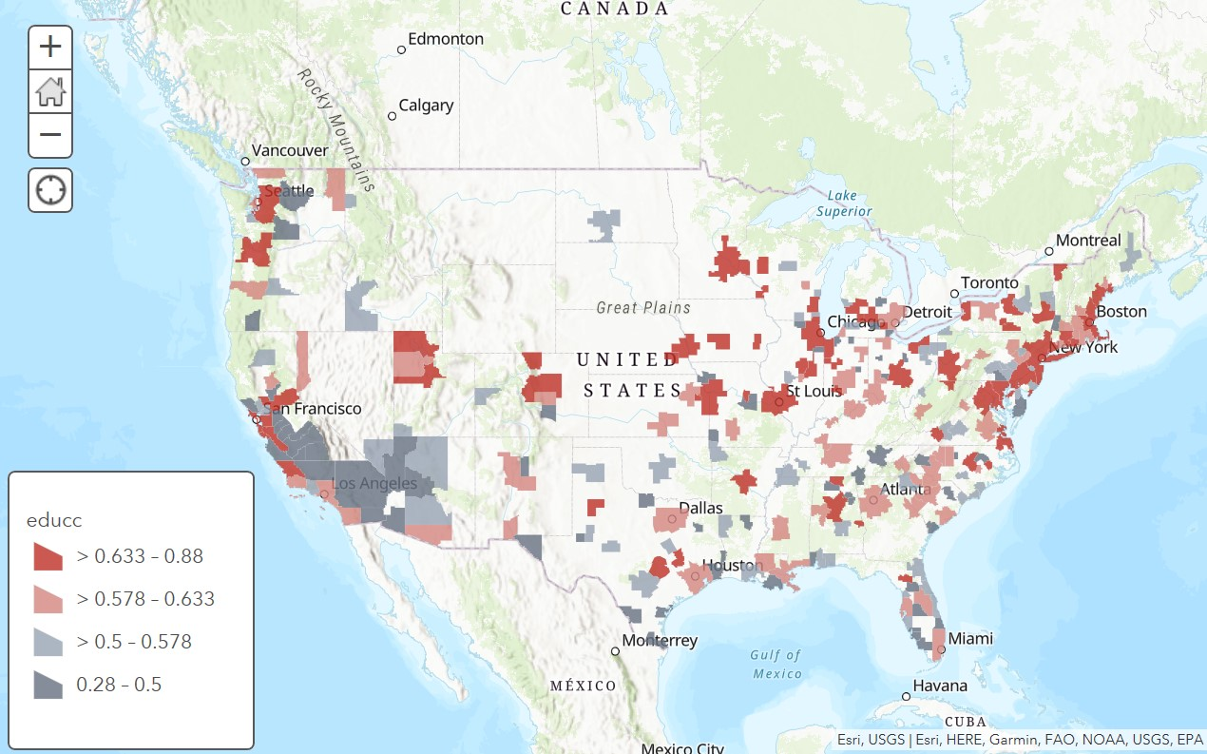

Slide 7
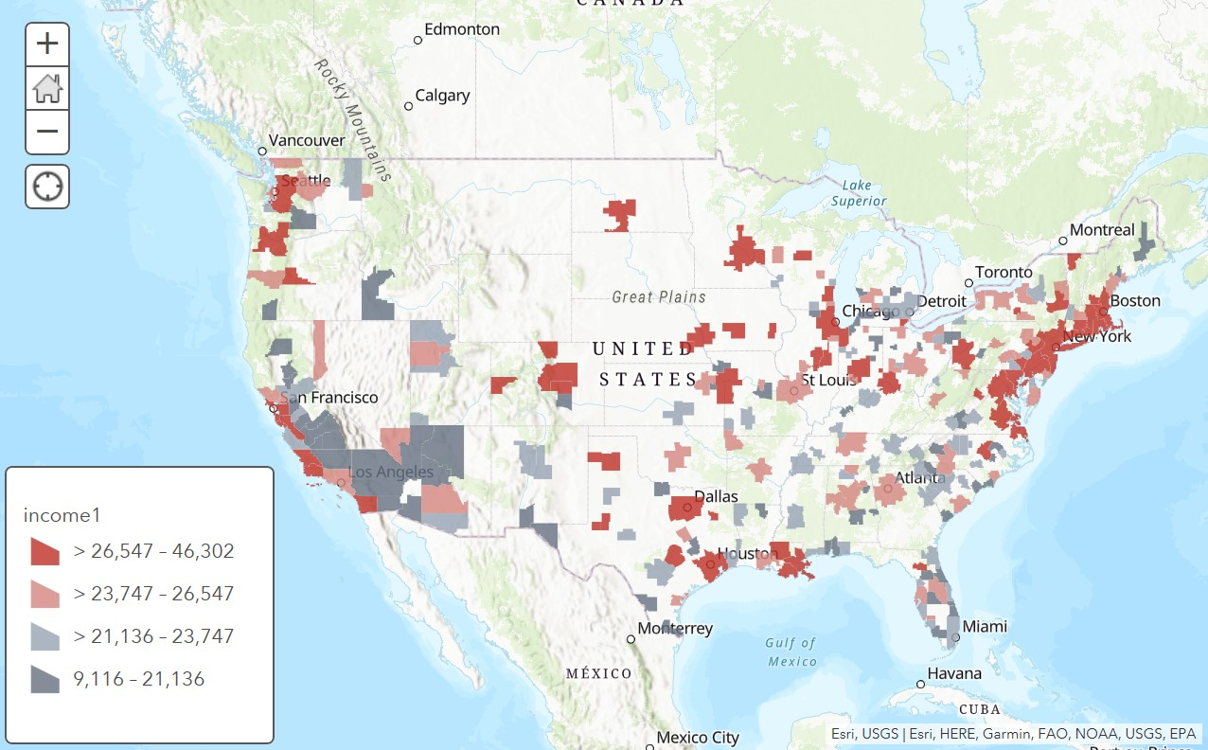

Slide 8
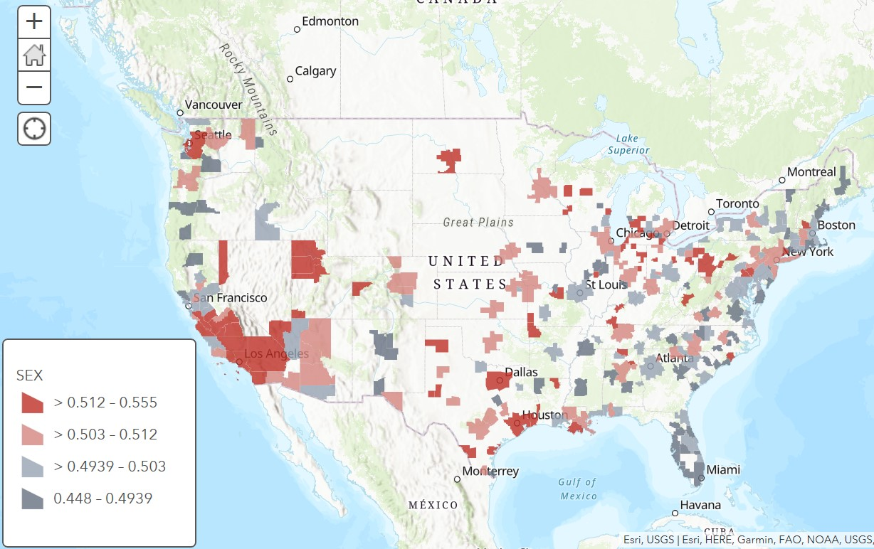

Slide 9
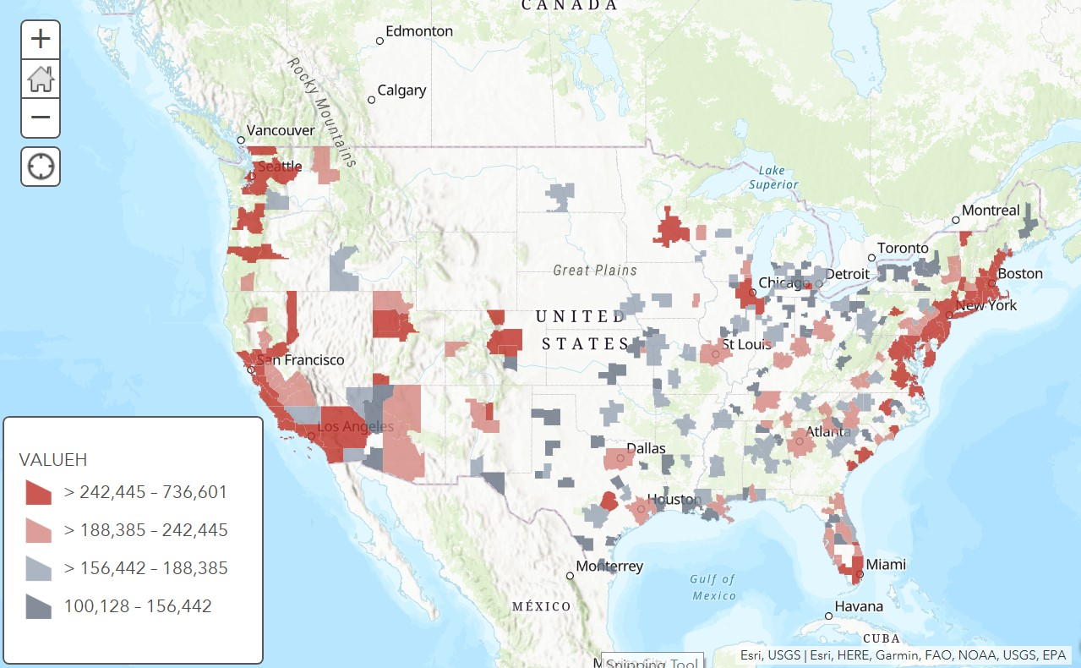

Slide 10
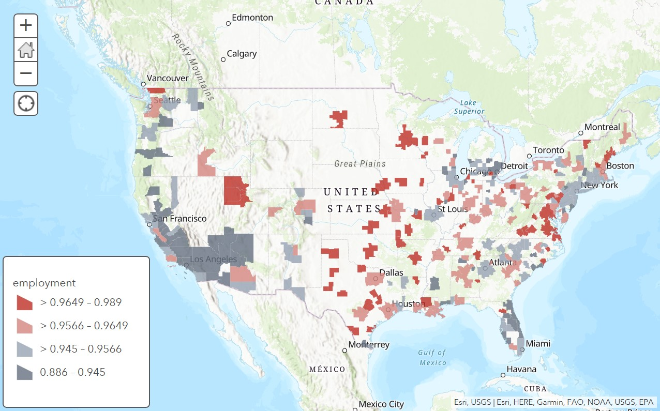

Slide 11
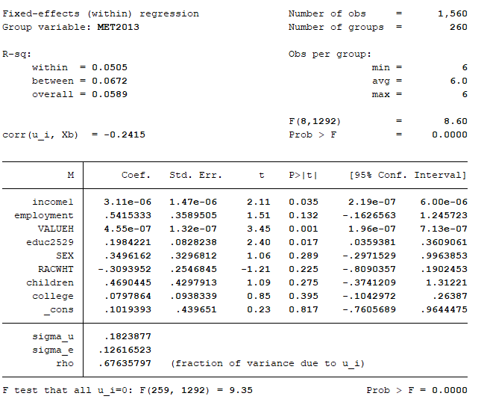
Preliminary results

